Slide 1


PROJECT
Social
Buzz

Slide 2


Today's agenda
Project recap
Problem
The Analytics team
Process
Insights
Summary

Slide 3

CHALLENGES :
- Managing massive unstructured data.
- Preparing for a successful IPO.
NEEDS:
- Expert guidance to optimize big data practices.
- Ensuring IPO readiness.
- Strengthening systems for sustainable scalability.
Project Recap

Slide 4

Problem :
Over 100000 posts per day
36 500 000 pieces of content per year!
But how to capitalize on it when there is so much?
categories of content.

Slide 5

The Analytics team
Mr. Gururaj Ingavale
Undergraduate AI&DS
Engineer

Slide 6

Decision Making
Process
1
Strategical Thinking
2
3
Data Manipulation
4
Data Visualization
5

Slide 7

Insights
Social buzz refers to the overall online chatter, interactions, and discussions surrounding a topic, brand, product, or event on social media platforms. Here are different insights that can be drawn from social buzz:
Volume of Buzz - Definition: The total number of mentions or discussions about a topic or brand over a specific period.
- Insight: Indicates the level of interest or popularity. A spike may signal a trend or crisis.
2. Sentiment Analysis - Definition: The overall tone of the discussions (positive, negative, or neutral).
Insight: Reveals public perception and mood towards a brand or topic, helping identify issues or strengths.
3. Key Topics and Trends - Definition: Specific themes, hashtags, or topics frequently associated with the buzz.
Insight: Highlights what resonates most with the audience or what drives the conversation.
4. Engagement Metrics - Definition: Likes, shares, comments, and retweets linked to the buzz.
Insight: Indicates how much and how deeply people are interacting with the content.
5. Influencer Contributions - Definition: Identifying key individuals or accounts driving the buzz.
- Insight: Helps target influencers for collaboration or monitor their impact on public opinion.

Slide 8
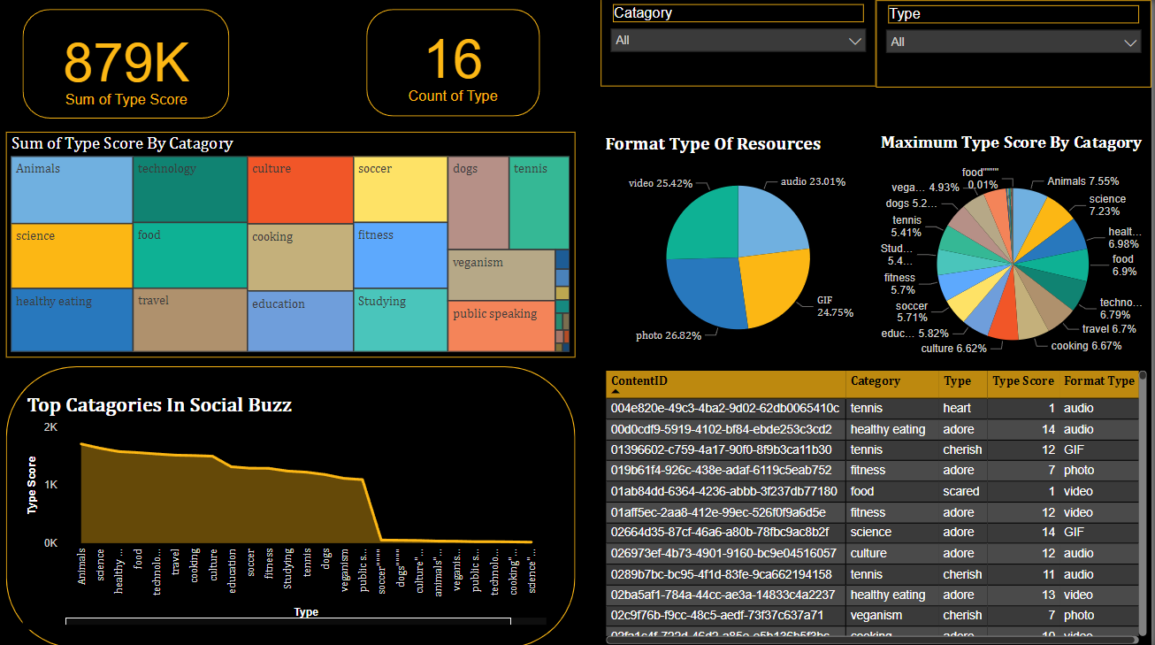

Slide 9
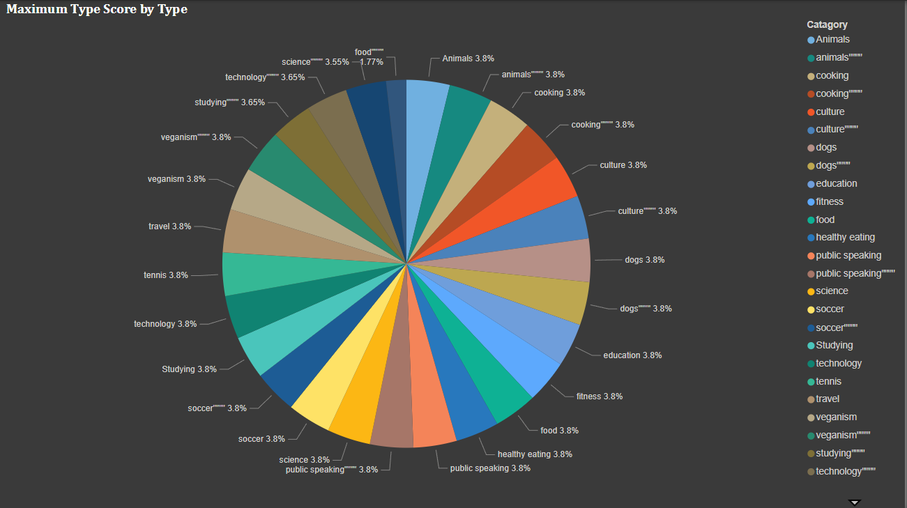

Slide 10
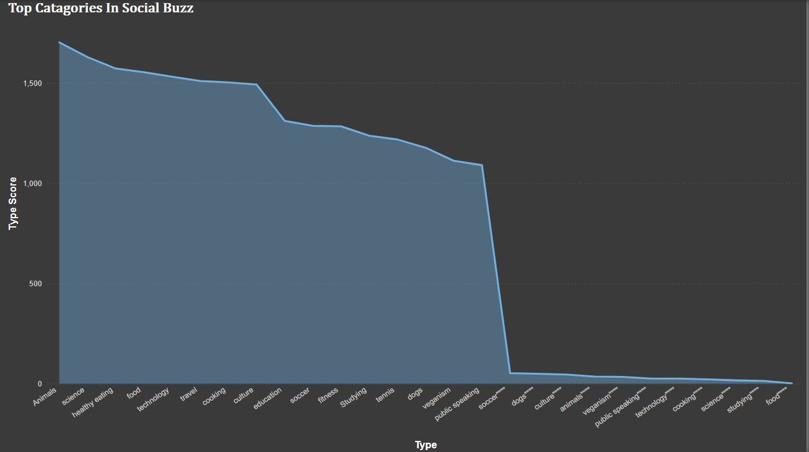

Slide 11

Social Buzz refers to the widespread conversation, engagement, and activity generated around a topic, event, brand, or individual on social media platforms. It is a measure of online interest and can be driven by posts, shares, likes, comments, and trending hashtags. Businesses and influencers often aim to create social buzz to increase visibility, attract followers, and enhance brand recognition. Tools like sentiment analysis and social media listening platforms are commonly used to track and measure social buzz, helping gauge public sentiment and the overall impact of the content or campaign.
Summary

Slide 12
Thank you!
ANY QUESTIONS?

